Slide 1
Online Car Parking Management System
{Sheeraz Ali ˚Qaswar Sarfarz ˚HooriaSajid ˚Musa Mumtaz ˚Sadia}

Slide 2
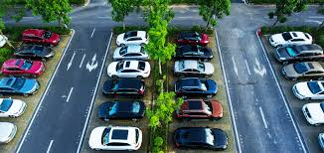
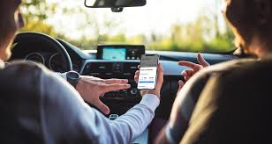
Online Car Parking Management System
The car parking management system is a comprehensive software solution that helps efficiently manage and optimize parking facilities. It provides a user-friendly interface to streamline parking operations, improve customer experience, and enhance overall parking efficiency.

Slide 3
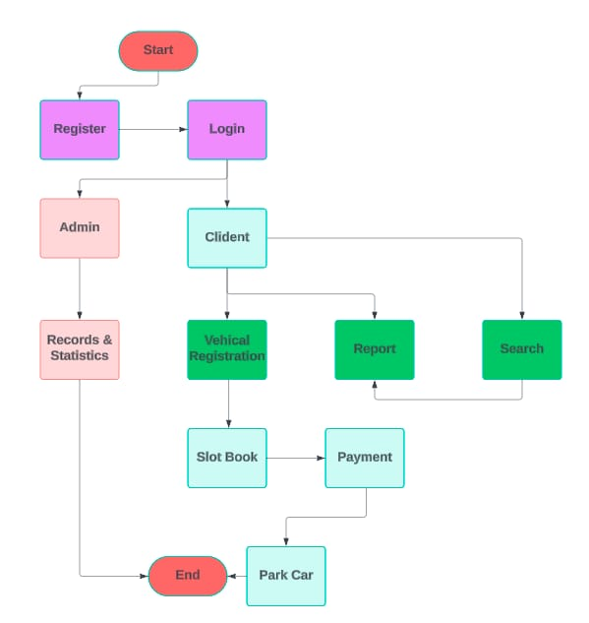
Flow OF The Program

Slide 4

Key Features and Functionalities
1
2
Intuitive User Interface
Reporting and Analytics
The system provides a user-friendly and easy-to-navigate interface for both customers and administrators.
Comprehensive reporting and analytics tools help managers make data-driven decisions.
3
4
Access Control Integration
Mobile App Integration
The system seamlessly integrates with access control systems for secure and automated parking access.
Customers can use a mobile app to reserve, pay, and manage their parking experiences.

Slide 5
File Handling and Database Management
File Storage
Database Integration
The system utilizes file handling to store and manage customer records, parking transactions, and other relevant data.
A robust database management system is integrated to provide secure and reliable data storage and retrieval.
Data Backup and Recovery
Data Analytics
Automated backup and disaster recovery mechanisms ensure the safety and integrity of all stored data.
The database supports advanced analytics and reporting capabilities to generate insights and support decision-making.

Slide 6
Conclusion and Future Enhancement
Conclusion
Future Enhancements
The car parking management system provides a comprehensive solution to streamline parking operations, enhance customer satisfaction, and optimize resource utilization.
Potential future enhancements include integrating smart parking sensors, implementing dynamic pricing, and incorporating AI-powered analytics for predictive parking management.

Slide 7
THANKS!
Do you have any questions?
string
collaborators[5]=
{Sheeraz Ali,
Qaswar Sarfarz,
Hooria Sajid,
Musa Mumtaz
Sadia};
Please, keep this slide for attribution.

